Slide 1
COMP 4290
Week 6 - Friday

Slide 2
Last time
What did we talk about last time?
Exam 1!
Before that:
Review
Attacks against hash functions
Digital signatures

Slide 3
Questions?

Slide 4
Project 2

Slide 5
Olivia Crespo Presents

Slide 6
Quantum Cryptography

Slide 7
Quantum cryptography
When people talk about quantum computers in the context of cryptography, they're usually talking about one of two very different things:
Breaking cryptography with quantum computers
Using quantum mechanics to send secret messages

Slide 8
Quantum computers
A quantum computer is built using qubits instead of classical bits for memory
A qubit is not necessarily 1 or 0
Instead, it can be a superposition of them (both at the same time)
A quantum computer may be able to explore many possible answers at the same time
After computation is complete, the qubits are measured
Measuring collapses their quantum states into either 1's or 0's

Slide 9
Shor's algorithm
Shor's algorithm is an algorithm invented by Peter Shor in 1994 to factor integers
With enough qubits, Shor's algorithm can factor an integer in O((log N)²(log log N)(log log log N)) time
In other words, polynomial in the length of the number N that is being factored
RSA depends on the difficulty of factoring
Shor's algorithm can be adapted to solve the discrete log problem as well

Slide 10
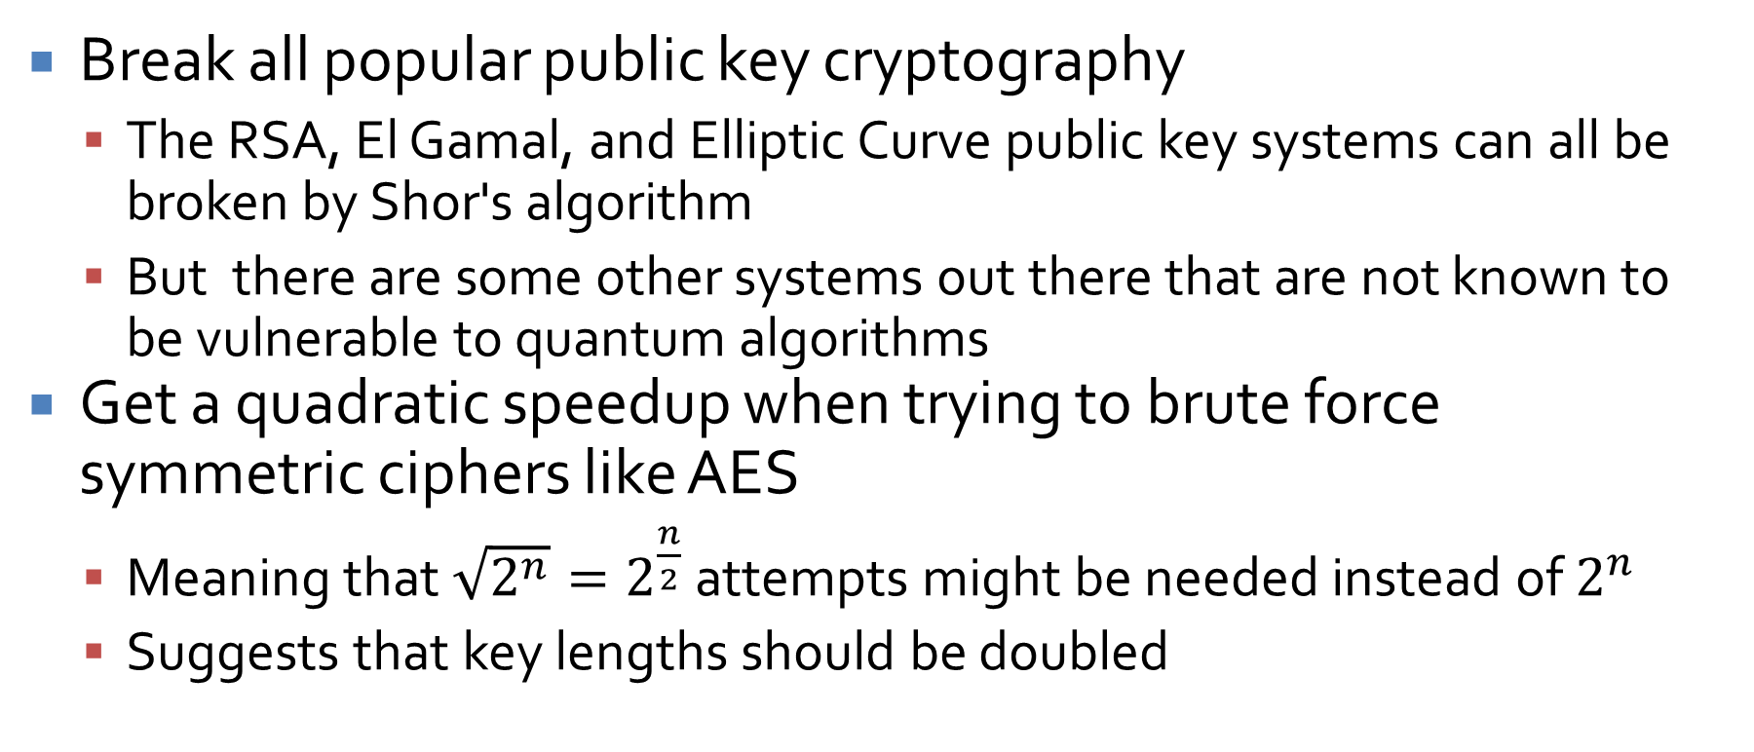
What a quantum computer could do
Break all popular public key cryptography
The RSA, El Gamal, and Elliptic Curve public key systems can all be broken by Shor's algorithm
But there are some other systems out there that are not known to be vulnerable to quantum algorithms
Get a quadratic speedup when trying to brute force symmetric ciphers like AES
Meaning that $\sqrt{2^{n}}=2^{\frac{n}{2}}$ attempts might be needed instead of $2^{n}$
Suggests that key lengths should be doubled

Slide 11
What quantum computers have done
2001: Factor 15 into 3 × 5
2012: Factor 21 into 3 × 7
2012: Factor 143 into 11 × 13
2012: Factor 56153 into 241 × 233 (although not realized until 2014)
2019: A Google quantum computer sampled a random quantum circuit 1,000,000 times in just over 3 minutes when simulating it with a supercomputer would have taken 10,000 years …
2022: Factor 261980999226229 into 15538213 × 16860433 (but using a kind of quantum computer that probably won't work for much larger numbers)
2024: Google quantum computer did something in 5 minutes they claim would take a supercomputer 10 septillion years to solve …
There is some progress!
The bigger factoring ones are using a different approach to quantum computing than Shor's algorithm
A breakthrough could be soon …

Slide 12
Technical problems
There are lots of approaches for making quantum computers
But none of them look very good yet
It's hard to make qubits that behave right
It's hard to make algorithms that efficiently query the qubits
A phenomenon called quantum decoherence causes qubits to lose their superposition
Some quantum computers have to be cooled to almost absolute zero to reduce decoherence
D-Wave is the best known quantum computer manufacturer
So far, none of their computers outperform classical computers on tasks that most people care about

Slide 13
Quantum resistant algorithms
Because of potential quantum advances, cryptographers have worked on quantum-resistant algorithms, also called post-quantum cryptography (PQC)
Kyber is a key encapsulation mechanism with 512, 768, and 1024 bit keys that is supposed to be as strong as AES with 128, 192, and 256 bit keys, in a quantum environment
It shares symmetric keys (like AES), instead of something like RSA or Diffie-Hellman
It uses lattice theory, a deep math thing
There are also hash-based approaches to PQC
AES using 256 bit keys is considered quantum secure

Slide 14
Quantum communication
The other (and possibly more useful) way to use quantum mechanics is as a way to send secret information
To do so, Sam (the sender) sends Ruth (the receiver) photons
What's really remarkable about this kind of quantum cryptography is that no one can eavesdrop on it

Slide 15
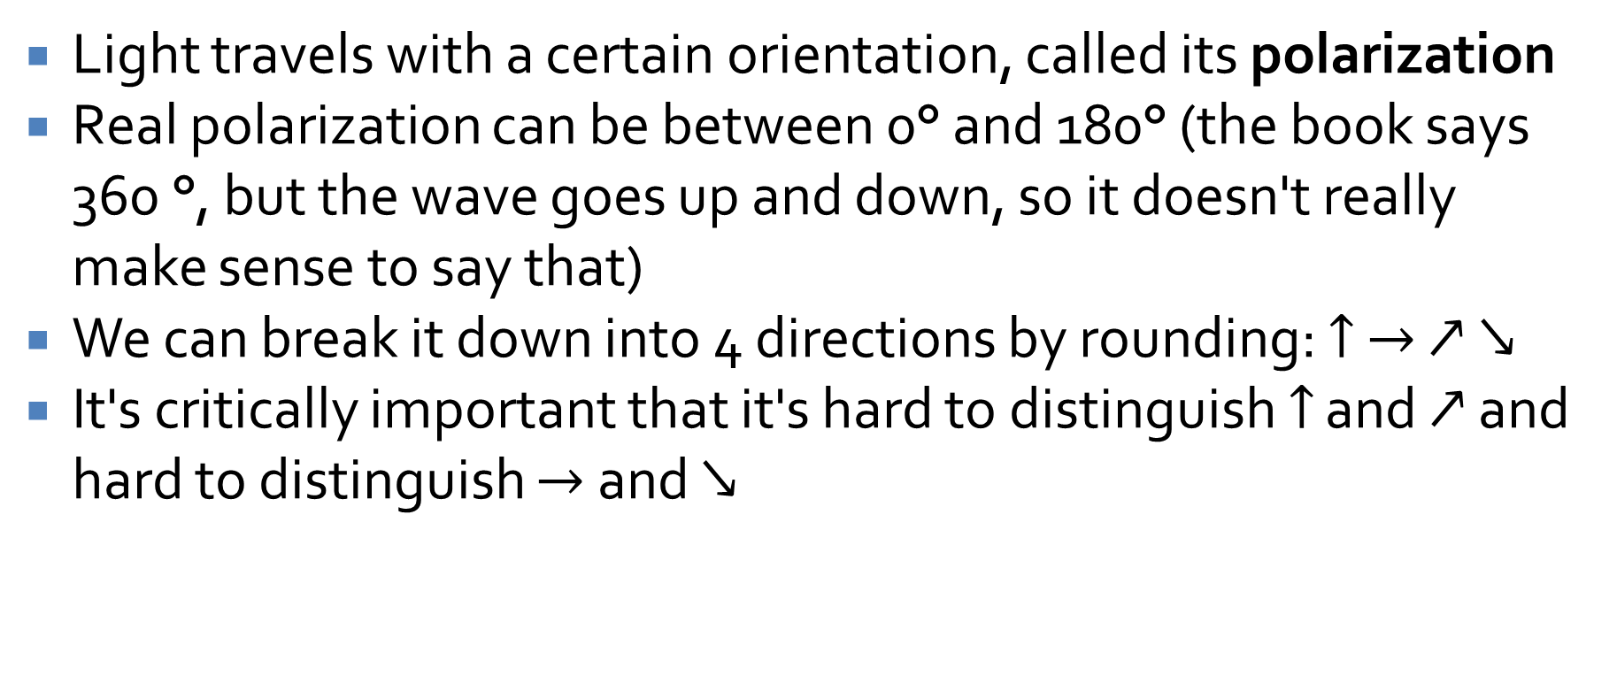
The setup
Light travels with a certain orientation, called its polarization
Real polarization can be between 0° and 180° (the book says 360 °, but the wave goes up and down, so it doesn't really make sense to say that)
We can break it down into 4 directions by rounding: $↑$ $→$ $↗$ $↘$
It's critically important that it's hard to distinguish $↑$ and $↗$ and hard to distinguish $→$ and $↘$

Slide 16
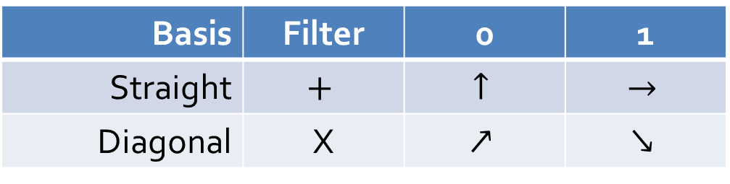
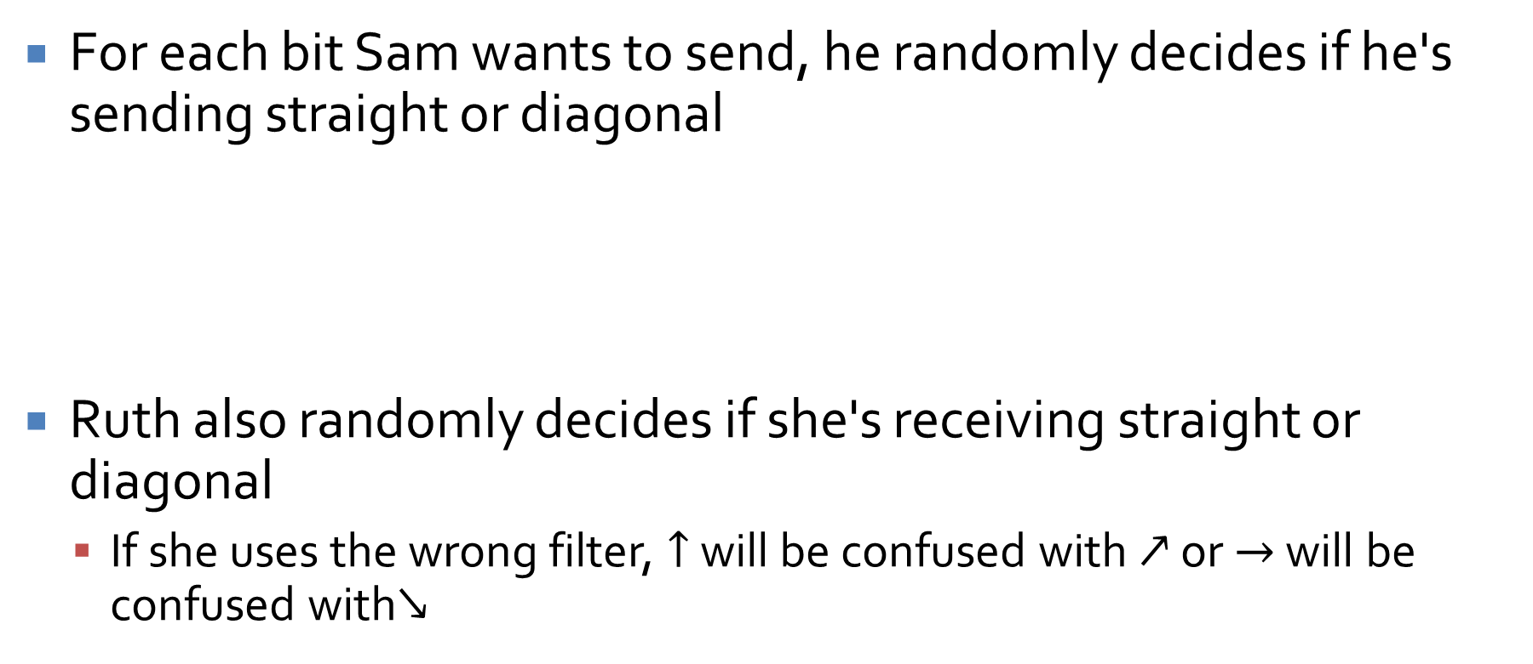
Sending
For each bit Sam wants to send, he randomly decides if he's sending straight or diagonal
Ruth also randomly decides if she's receiving straight or diagonal
If she uses the wrong filter, $↑$ will be confused with $↗$ or $→$ will be confused with$↘$
Basis | Filter | 0 | 1
Straight | $$+$$ | $$↑$$ | $$→$$
Diagonal | X | $$↗$$ | $$↘$$

Slide 17
Receiving
Ruth receives symbols, but she isn't sure what she got
On a public channel, she tells Sam which basis she was using for each bit
Then Sam knows which ones she would have gotten right and which ones she would have gotten wrong
He tells her which ones she would have gotten right
Those are the ones that they keep

Slide 18
Why this works
It's not a great way to send a message
But it is a great way to agree on random bits
In other words, a session key for regular communication
If Eve is eavesdropping, quantum properties say that she'll disturb the polarization of the photons
Thus, Ruth will get garbage
To make sure that no one is eavesdropping, Sam and Ruth share some bits publically, to see if they agree

Slide 19
Technical problems
Most importantly, the process is inefficient
On average, half of the bits are bad, since Ruth had the wrong filter
Even more bits have to be ignored in order to do error checking and testing to see if there was an eavesdropper
Making the actual photon guns isn't easy, although a kind of pulsed laser has been successfully used
Another problem is that you have to have an optical quantum channel with anyone you want to exchange a key with
Either through the atmosphere or through fiber optics

Slide 20
Successes
This technology is moving from theory into practice
Government labs in the US and the UK have tested devices working through the atmosphere at up to 45 km
Businesses that want to send high security traffic may negotiate keys using quantum key distribution in our lifetimes

Slide 21
Program Security

Slide 22
Secure programs
For now, we will be pretty broad in our definition of programs
OS
Applications
Databases
Almost any other software
What is a secure program?
How do we know?
How do we keep programs free from flaws?
How do we protect computing resources against programs that contain flaws?

Slide 23
Fixing faults
We can judge security by the number of faults found in a program
Count the number of faults found and fixed
Program is good if it has few faults to begin with, right?
But isn't the program good if we've fixed a lot of faults?
Which is more meaningful?

Slide 24
Penetrate and patch
In the early days, security was shown by finding faults and patching them
Unfortunately, patching a fault often led to creating another one
Why?
The patch fixed a narrow problem, but the cause was more general
The fault had non-obvious side effects
Fixing one problem caused a problem somewhere else
The fault was poorly fixed because a proper fix might impact functionality or performance

Slide 25
Terminology
We talk about software bugs, but the term is vague
The IEEE favors the following:
Error: A human mistake in developing software (bad design, bad implementation, typo… )
Fault: An incorrect step inside of a program (many faults can be caused by a single error)
Failure: A system departing from its required behavior (a failure might not happen if a particular fault is never executed)

Slide 26
Unexpected behavior
Unexpected behavior is called a program security flaw
The IEEE terminology is for software engineering and doesn't match exactly
A program security flaw could be a fault or a failure
Intentional security incidents are called cyber attacks
Cyber attacks are not as common as the problems caused by unintentional flaws

Slide 27
Why is life so hard?
It's very difficult to eliminate program security flaws for two reasons:
Programs should do a long list of operations correctly and shouldn't do another (possibly infinite) list of operations
The number of combinations to test is staggering
Software engineering develops faster than computer security
We're always playing catch-up

Slide 28
Non-malicious program errors

Slide 29
Flaws
Landwehr et al. divided flaws into intentional and inadvertent
The inadvertent flaws were divided into six categories
Validation: Incomplete or inconsistent permission checks
Domain: Poorly controlled access to data
Serialization and aliasing: Mistakes in program flow order
Identification and authentication: Incorrect basis for authentication
Boundary condition: Failure on the first or last case
Logic: Any mistakes in logic not already covered
Other lists have been made, but this one is representative
The next slides will cover some common types

Slide 30
Buffer overflows
A buffer overflow happens when data is written past the end (or beginning) of an array
Consider the following Java code:
In Java, this code will throw an ArrayIndexOutOfBoundsException, but it will not write memory where it shouldn't
In C/C++, it might
char[] buffer = new char[10];
for(int i = 0; i < 10; ++i) {
buffer[i] = 'A';
}
buffer[10] = 'B';

Slide 31
Buffer overflow
It could overwrite:
User data
User code
System data
System code
User Data
 |  |  |  |  | A | A | A | A | A | A | A | A | A | A | B
User Data
User Code
 |  |  |  |  | A | A | A | A | A | A | A | A | A | A | B
User Data
System Data
 |  |  |  |  | A | A | A | A | A | A | A | A | A | A | B
User Data
System Code
 |  |  |  |  | A | A | A | A | A | A | A | A | A | A | B

Slide 32
Buffer overflow security
Without the presence of malicious attackers, buffer overflows can corrupt your data (or the system's) or crash your program
A malicious attacker can exploit buffer overflows
By inserting data into system data or code so that the system does what he or she wants
By overwriting the stack pointer to cause arbitrary code in the attacker's memory to be executed
Memory segmentation makes these attacks less common but still possible

Slide 33
Upcoming

Slide 34
Next time…
Malicious code
Start countermeasures
Ashley Gutierrez presents

Slide 35
Reminders
Read sections 3.1, 3.2, and 3.3
Start on Project 2

